Slide 1
CREATING AND MANAGING TABLES

Slide 2
Objectives
After completing this lesson, you should be able to do the following:
Review the table structure
List the data types that are available for columns
Create a simple table
Alter table definitions
Drop, rename, and truncate tables
Notes:
Objectives
In this lesson, you are introduced to the data definition language (DDL) statements. You are taught the basics of how to create simple tables, alter them, and remove them. The data types available in DDL are shown, and schema concepts are introduced. Constraints are tied into this lesson. Exception messages that are generated from violating constraints during DML are shown and explained.

Slide 3
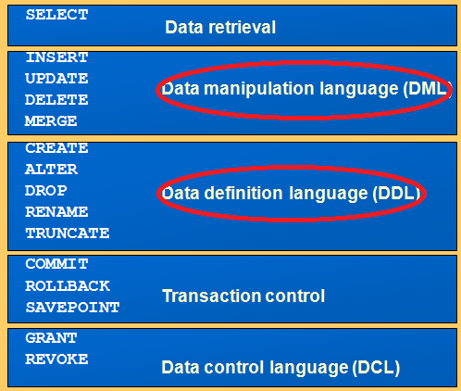
REVIEW: SQL STATEMENTS

Slide 4
Naming Rules
Table names and column names:
Must begin with a letter
Must be 1–30 characters long
Must contain only A–Z, a–z, 0–9, _, $, and #
Must not duplicate the name of another object owned by the same user
Must not be an Oracle server reserved word
Notes:
Naming Rules
You name database tables and columns according to the standard rules for naming any Oracle database object:
Table names and column names must begin with a letter and be 1–30 characters long.
Names must contain only the characters A–Z, a–z, 0–9, _ (underscore), $, and # (legal characters, but their use is discouraged).
Names must not duplicate the name of another object owned by the same Oracle server user.
Names must not be an Oracle server reserved word.
Naming Guidelines
Use descriptive names for tables and other database objects.
Note: Names are case-insensitive. For example, EMPLOYEES is treated as the same name as eMPloyees or eMpLOYEES.
For more information, see “Object Names and Qualifiers” in the Oracle Database SQL Reference.

Slide 5

CREATE TABLE Statement
You must have:
CREATE TABLE privilege
A storage area
You specify:
Table name
Column name, column data type, and column size
CREATE TABLE [schema.]table
(column datatype [DEFAULT expr][, ...]);
Notes:
CREATE TABLE Statement
You create tables to store data by executing the SQL CREATE TABLE statement. This statement is one of the DDL statements, which are a subset of SQL statements used to create, modify, or remove Oracle database structures. These statements have an immediate effect on the database, and they also record information in the data dictionary.
To create a table, a user must have the CREATE TABLE privilege and a storage area in which to create objects. The database administrator uses data control language statements to grant privileges to users (DCL statements are covered in a later lesson).
In the syntax:
schema is the same as the owner’s name
table is the name of the table
DEFAULT expr specifies a default value if a value is omitted in the INSERT statement
column is the name of the column
datatype is the column’s data type and length

Slide 6
Data Types
Data Type | Description
VARCHAR2(size) | Variable-length character data
CHAR(size) | Fixed-length character data
NUMBER(p,s) | Variable-length numeric data
DATE | Date and time values
LONG | Variable-length character data (up to 2 GB)
CLOB | Character data (up to 4 GB)
RAW and LONG RAW | Raw binary data
BLOB | Binary data (up to 4 GB)
BFILE | Binary data stored in an external file (up to 4 GB)
ROWID | A base-64 number system representing the unique address of a row in its table
Notes:
Data Types
When you identify a column for a table, you need to provide a data type for the column. There are several data types available:

Slide 7
DEFAULT Option
Specify a default value for a column during an insert.
The default data type must match the column data type.
Example 1:
... hire_date DATE DEFAULT SYSDATE, ...
CREATE TABLE hire_dates (id NUMBER(8),
hire_date DATE DEFAULT SYSDATE);
Table created.
Notes:
DEFAULT Option
When you define a table, you can specify that a column be given a default value by using the DEFAULT option. This option prevents null values from entering the columns if a row is inserted without a value for the column. The default value can be a literal, an expression, or a SQL function (such as SYSDATE or USER), but the value cannot be the name of another column or a pseudocolumn (such as NEXTVAL or CURRVAL). The default expression must match the data type of the column.
Note: CURRVAL and NEXTVAL are explained later in this lesson.

Slide 8
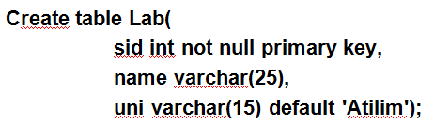
DEFAULT: Varsayılan değer kısıtı- Tabloda bir alana herhangi bir değer girilmezse, ( tanımlama sırasında varsayılan bir değer atanmışsa) alana o değer atanır.
Örnek:
uni niteliğine herhangi bir değer girmezsek, varsayılan değer olarak uni alanina Atılım’ın yazılmasını bekleriz.

Slide 9
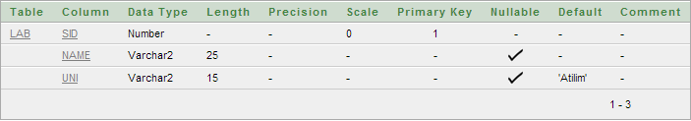
Creating Tables
Confirm table creation: To learn the structure of a table, use DESC command. (Displays the current table columns and type definitions.)
DESC Lab OR DESRCIBE Lab
Notes:
Creating Tables
The example on the slide creates the DEPT table, with three columns: DEPTNO, DNAME, and LOC. It further confirms the creation of the table by issuing the DESCRIBE command.
Since creating a table is a DDL statement, an automatic commit takes place when this statement is executed.
Instructor Note
Explain that additional syntax for CREATE TABLE could include constraints and so on. For more information on the CREATE TABLE syntax, refer to: Oracle9i SQL Reference, “CREATE TABLE. ”

Slide 10

Including Constraints
Constraints enforce rules at the table level.
Constraints prevent the deletion of a table if there are dependencies.
The following constraint types are valid:
NOT NULL
UNIQUE
PRIMARY KEY
FOREIGN KEY
Notes:
Constraints
The Oracle server uses constraints to prevent invalid data entry into tables.
You can use constraints to do the following:
Enforce rules on the data in a table whenever a row is inserted, updated, or deleted from that table. The constraint must be satisfied for the operation to succeed.
Prevent the deletion of a table if there are dependencies from other tables
Provide rules for Oracle tools, such as Oracle Developer
Data Integrity Constraints

Slide 11
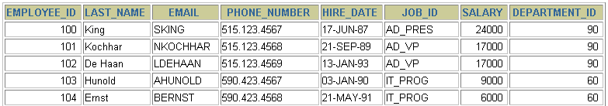
NOT NULL Constraint
Ensures that null values are not permitted for the column:
…
NOT NULL constraint
(No row can contain a null value for this column.)
NOT NULL
constraint
Absence of NOT NULL constraint (Any row can contain a null value for this column.)
Notes:
NOT NULL Constraint
The NOT NULL constraint ensures that the column contains no null values. Columns without the NOT NULL constraint can contain null values by default. NOT NULL constraints must be defined at the column level.

Slide 12
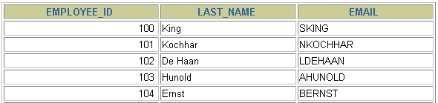
UNIQUE Constraint
UNIQUE constraint
EMPLOYEES
…
INSERT INTO
Allowed
Not allowed: already exists
Notes:
UNIQUE Constraint
A UNIQUE key integrity constraint requires that every value in a column or set of columns (key) be unique—that is, no two rows of a table can have duplicate values in a specified column or set of columns. The column (or set of columns) included in the definition of the UNIQUE key constraint is called the unique key. If the UNIQUE constraint comprises more than one column, that group of columns is called a composite unique key.
UNIQUE constraints enable the input of nulls unless you also define NOT NULL constraints for the same columns. In fact, any number of rows can include nulls for columns without NOT NULL constraints because nulls are not considered equal to anything. A null in a column (or in all columns of a composite UNIQUE key) always satisfies a UNIQUE constraint.
Note: Because of the search mechanism for UNIQUE constraints on more than one column, you cannot have identical values in the non-null columns of a partially null composite UNIQUE key constraint.

Slide 13
UNIQUE Constraint
Defined at either the table level or the column level:
CREATE TABLE employees(
employee_id NUMBER(6),
last_name VARCHAR2(25) NOT NULL,
email VARCHAR2(25),
salary NUMBER(8,2),
commission_pct NUMBER(2,2),
hire_date DATE NOT NULL,
...
CONSTRAINT emp_email_uk UNIQUE(email));
Notes:
UNIQUE Constraint (continued)
UNIQUE constraints can be defined at the column level or table level. A composite unique key is created by using the table-level definition.
The example in the slide applies the UNIQUE constraint to the EMAIL column of the EMPLOYEES table. The name of the constraint is EMP_EMAIL_UK..
Note: The Oracle server enforces the UNIQUE constraint by implicitly creating a unique index on the unique key column or columns.

Slide 14
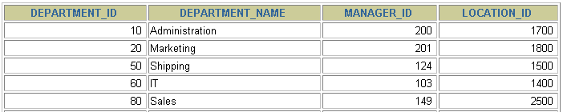
PRIMARY KEY Constraint
DEPARTMENTS
PRIMARY KEY
…
Not allowed
(null value)
INSERT INTO
Not allowed
(50 already exists)
Notes:
PRIMARY KEY Constraint
A PRIMARY KEY constraint creates a primary key for the table. Only one primary key can be created for each table. The PRIMARY KEY constraint is a column or set of columns that uniquely identifies each row in a table. This constraint enforces uniqueness of the column or column combination and ensures that no column that is part of the primary key can contain a null value.
Note: Because uniqueness is part of the primary key constraint definition, the Oracle server enforces the uniqueness by implicitly creating a unique index on the primary key column or columns.

Slide 15
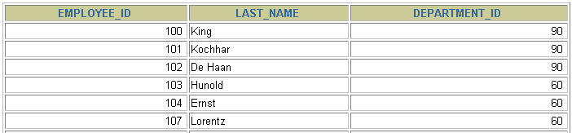
FOREIGN KEY Constraint
DEPARTMENTS
PRIMARY KEY
…
EMPLOYEES
FOREIGN KEY
…
INSERT INTO
Not allowed (9 does not exist)
Allowed
Notes:
FOREIGN KEY Constraint
The FOREIGN KEY (or referential integrity) constraint designates a column or combination of columns as a foreign key and establishes a relationship between a primary key or a unique key in the same table or a different table.
In the example in the slide, DEPARTMENT_ID has been defined as the foreign key in the EMPLOYEES table (dependent or child table); it references the DEPARTMENT_ID column of the DEPARTMENTS table (the referenced or parent table).
Guidelines
A foreign key value must match an existing value in the parent table or be NULL.
Foreign keys are based on data values and are purely logical, rather than physical, pointers.

Slide 16
FOREIGN KEY Constraint
Defined at either the table level or the column level:
CREATE TABLE employees(
employee_id NUMBER(6),
last_name VARCHAR2(25) NOT NULL,
email VARCHAR2(25),
salary NUMBER(8,2),
commission_pct NUMBER(2,2),
hire_date DATE NOT NULL,
...
department_id NUMBER(4),
CONSTRAINT emp_dept_fk FOREIGN KEY (department_id)
REFERENCES departments(department_id),
CONSTRAINT emp_email_uk UNIQUE(email));
Notes:
FOREIGN KEY Constraint (continued)
FOREIGN KEY constraints can be defined at the column or table constraint level. A composite foreign key must be created by using the table-level definition.
The example in the slide defines a FOREIGN KEY constraint on the DEPARTMENT_ID column of the EMPLOYEES table, using table-level syntax. The name of the constraint is EMP_DEPTID_FK.
The foreign key can also be defined at the column level, provided the constraint is based on a single column. The syntax differs in that the keywords FOREIGN KEY do not appear. For example:
CREATE TABLE employees
(...
department_id NUMBER(4) CONSTRAINT emp_deptid_fk
REFERENCES departments(department_id),
...
)

Slide 17
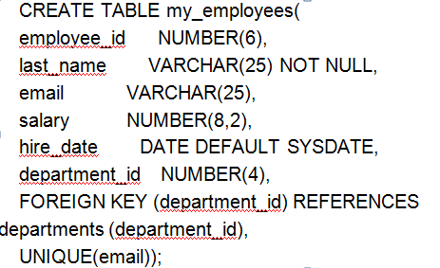
FOREIGN KEY Constraint

Slide 18
ALTER TABLE Statement
Use the ALTER TABLE statement to:
Add a new column: To add a column in a table, use the following syntax:
ALTER TABLE table_name ADD column_name datatype
Define a default value for the new column
Drop a column:
ALTER TABLE table_name DROP COLUMN column_name
Modify an existing column
Notes:
ALTER TABLE Statement
After you create a table, you may need to change the table structure for any of the following reasons:
You omitted a column.
Your column definition needs to be changed.
You need to remove columns.
You can do this by using the ALTER TABLE statement. For information about the ALTER TABLE statement, see the Oracle Database 10g SQL Fundamentals II course.

Slide 19
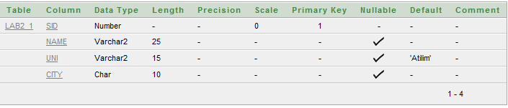
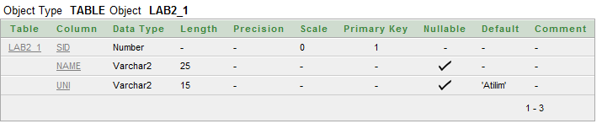
Example 3: Alter Table
3.1 ALTER TABLE LAB
ADD CITY CHAR(10)
3.2 DESC LAB
3.3 alter table lab
drop column city;
3.4 DESC LAB

Slide 20
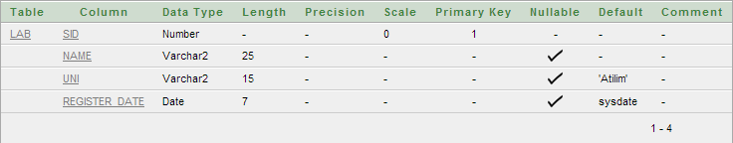
Example 3: Alter Table (Define a default value for the new column)
3.5 ALTER TABLE LAB
ADD Register_date Date default sysdate
3.6 DESC LAB

Slide 21
Dropping a Table
All data and structure in the table are deleted.
Any pending transactions are committed.
All indexes are dropped.
All constraints are dropped.
You cannot roll back the DROP TABLE statement.
DROP TABLE Orders;
Table dropped.
Notes:
Dropping a Table
The DROP TABLE statement removes the definition of an Oracle table. When you drop a table, the database loses all the data in the table and all the indexes associated with it.
Syntax
DROP TABLE table
In the syntax, table is the name of the table.
Guidelines
All data is deleted from the table.
Any views and synonyms remain but are invalid.
Any pending transactions are committed.
Only the creator of the table or a user with the DROP ANY TABLE privilege can remove a table.
Note: The DROP TABLE statement, once executed, is irreversible. The Oracle server does not question the action when you issue the DROP TABLE statement. If you own that table or have a high-level privilege, then the table is immediately removed. As with all DDL statements, DROP TABLE is committed automatically.

Slide 22
Changing the Name of an Table RENAME
To change the name of a table, you execute the RENAME statement.
You must be the owner of the table.
RENAME LAB TO LAB2;
Table renamed.
Notes:
Renaming a Table
Additional DDL statements include the RENAME statement, which is used to rename a table, view, sequence, or a synonym.
Syntax
RENAME old_name TO new_name;
In the syntax:
old_name is the old name of the table, view, sequence, or synonym.
new_name is the new name of the table, view, sequence, or synonym.
You must be the owner of the object that you rename.

Slide 23
Truncating a Table
The TRUNCATE TABLE statement:
Removes all rows from a table
Releases the storage space used by that table
TRUNCATE TABLE table_name;
You cannot roll back row removal when using TRUNCATE.
Alternatively, you can remove rows by using the DELETE statement.
Notes:
Truncating a Table
Another DDL statement is the TRUNCATE TABLE statement, which is used to remove all rows from a table and to release the storage space used by that table. When using the TRUNCATE TABLE statement, you cannot roll back row removal.
Syntax
TRUNCATE TABLE table;
In the syntax:
table is the name of the table
You must be the owner of the table or have DELETE TABLE system privileges to truncate a table.
The DELETE statement can also remove all rows from a table, but it does not release storage space. The TRUNCATE command is faster. Removing rows with the TRUNCATE statement is faster than removing them with the DELETE statement for the following reasons:
The TRUNCATE statement is a data definition language (DDL) statement and generates no rollback information.
Truncating a table does not fire the delete triggers of the table.
If the table is the parent of a referential integrity constraint, you cannot truncate the table. Disable the constraint before issuing the TRUNCATE statement.

